Slide 1

Emergency Shelter Daily Occupancy in AB
Group 4 :
Janvi Amish Patel
Sandeep Sandeep
Aina Faith Kehinde
Ebenezer Ireoluwa Adewola
Harman Sawant Loyee

Slide 2
Introduction
Emergency shelters provide critical and safe refuge to persons or families experiencing homelessness or who may be in crisis. These shelters provide temporary solutions when they are most needed, mostly under extreme weather conditions or such other disasters. Needs in Alberta are subject to variations based on factors like socio-economic challenges, seasonal variations, and unplanned events like the COVID-19 pandemic.
This dataset, spanning emergency shelter usage from the years 2020 to 2024, presents a detailed view of shelter capacities, overnight occupancy levels, and their variations across different cities and shelters in Alberta.

Slide 3
Problem Statement
Emergency shelters are critical for addressing homelessness and providing temporary refuge for vulnerable populations. Understanding the trends in shelter occupancy and their relationship with external factors, such as weather patterns, is essential for policymakers and service providers to allocate resources effectively and plan interventions. Despite the availability of occupancy data, there is a gap in comprehensive analysis of long-term trends and the extent to which weather conditions influence shelter usage in Alberta.

Slide 4
Dataset Information (Where did you get your data?)
The dataset contains 189,166 rows and 7 columns. That would suggest quite detailed information about emergency shelter occupation in the period 2020–2024 (From January 2020 to September 2024 ), covering several shelters and locations.
This dataset is taken from the Government of Alberta Open Data Portal. These datasets are related to homelessness and emergency shelters, mostly focusing on trends in shelter use, capacity, and overnight stay.

Slide 5
Methodology
Data Collection and Preprocessing: The dataset should be cleaned, transformed, and preprocessed to ensure its quality and consistency.
Exploratory Data Analysis: The trends, patterns, and correlations in the data are explored through visualization.
Statistical Analysis: Hypothesis testing and correlation analysis to prove key trends.
Predictive Modeling: Create models for predicting future demand to plan shelter and resources.
Best Practices and Recommendations: Provide actionable insights on how to improve shelter operations and inform policy decisions.

Slide 6
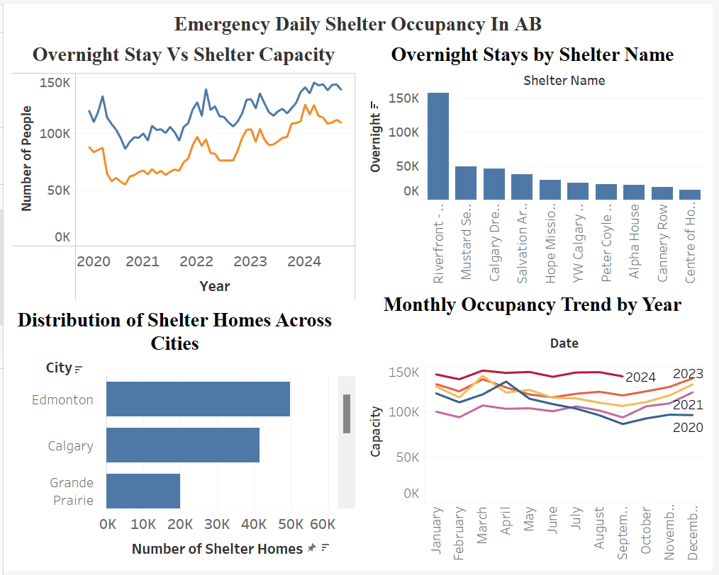
Dashboard

Slide 7
Key Insights
Seasonal and Temporal Trends: How shelter occupancy changes over the course of a year, and on certain days.
Capacity Utilization: Knowing whether shelters have sufficient capacity to meet demand or if they often experience overcrowding.
Impact of External Events: How weather, economic conditions, or crises affect shelter demand.
City-Level Differences: Variation in Shelter Use Across Alberta's Cities.
Predictive Modeling: Forecasting demand and resource optimization accordingly.
Vulnerable Populations: Identifying Groups Most in Need of Shelter Services.
Operational and Policy Recommendations: Using Data to Improve Effectiveness in the Shelter System.

Slide 8
Recommendations
Invest in Real-Time Data Systems: Develop systems to integrate real-time data streams from external sources like weather forecasts or public health alerts. Implement live dashboards for timely insights and decision-making.
Explore Advanced Machine Learning Techniques: Move beyond traditional models and explore deep learning to improve predictive accuracy, especially for complex and non-linear patterns in shelter demand.
Increase Data Diversity: Integrate external data sources such as economic indicators, social trends, and detailed demographic information to enhance prediction models and provide a comprehensive view of shelter demand.

Slide 9
Future Work
More Data Sources: It will allow a better understanding of shelter demand by using external datasets: local economic indicators, housing instability, and demographic data, including age, gender, and mental health status. This allows tailoring shelter services and predictions of future trends more accurately.
Real-Time Data Integration and Live Monitoring Dashboards : Integrating real-time data: weather, health, socio-economic indicators would increase demand prediction accuracy. A real-time monitoring dashboard would help shelter managers dynamically adjust resources and respond to changes in occupancy.
Advanced Machine Learning Models : Advanced machine learning techniques, such as Deep Learning, can be used to improve occupancy predictions. In addition, anomaly detection models can detect sudden demand spikes, and shelters can prepare ahead of time for unexpected surges.

